Slide 1
Bitwise operations

Slide 2
Numbers representation
Numbers in computer represented in binary numeral system.
Every decimal number you see at output or give to program by yourself converted to binary.
There are number of various binary representations for signed numbers.

Slide 3
Numbers representation
3 basic types of numbers representation in computer:
Sign and magnitude method.
Ones' complement.
Two's complement.

Slide 4
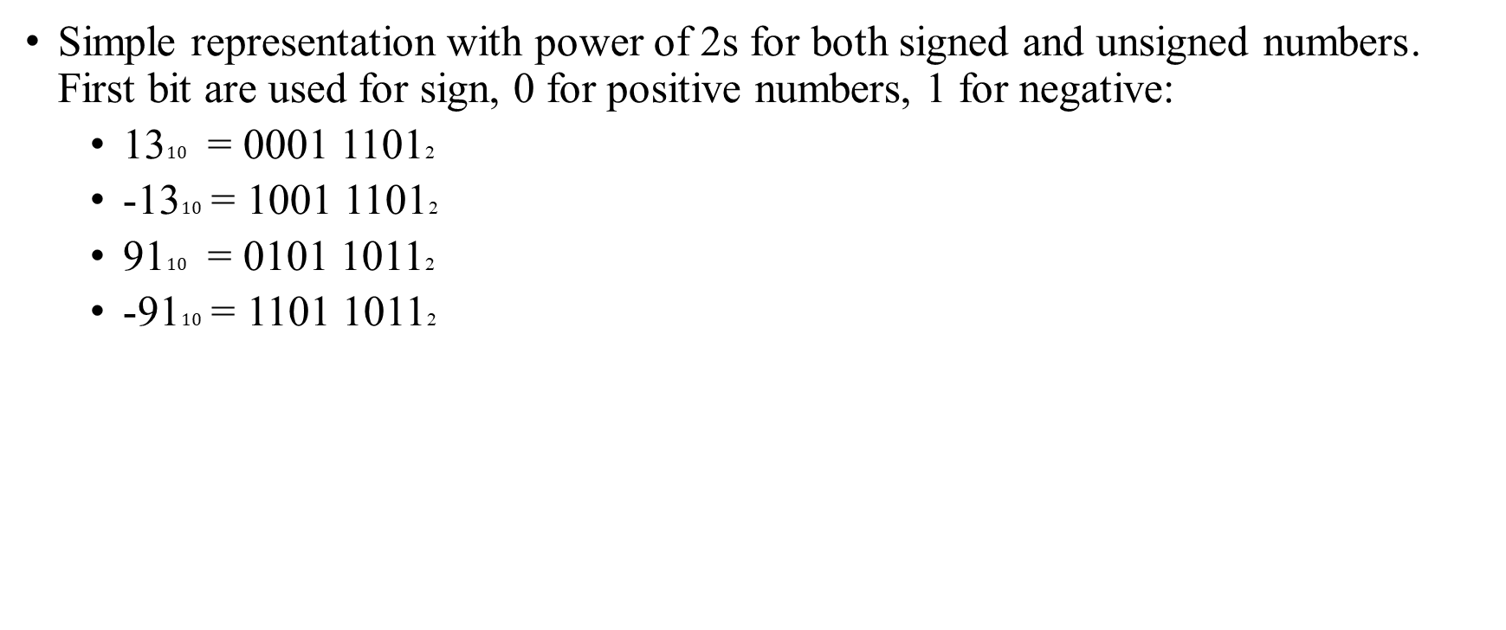
Numbers representation Sign and magnitude method
Simple representation with power of 2s for both signed and unsigned numbers․ First bit are used for sign, 0 for positive numbers, 1 for negative:
13$10$ = 0001 11012
-13$10$ = 1001 11012
91$10$ = 0101 10112
-91$10$ = 1101 10112

Slide 5
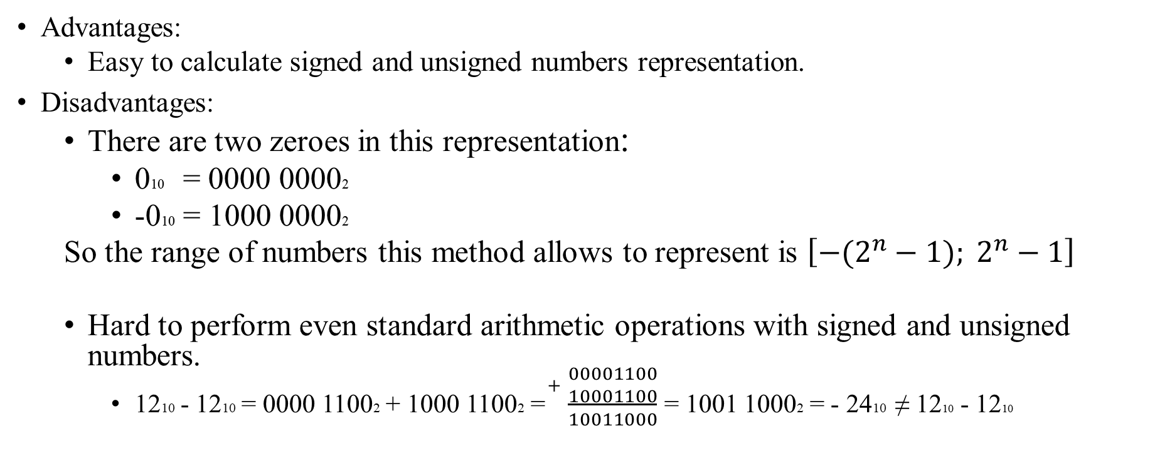
Numbers representation Sign and magnitude method
Advantages:
Easy to calculate signed and unsigned numbers representation.
Disadvantages:
There are two zeroes in this representation:
010 = 0000 00002
-010 = 1000 00002
So the range of numbers this method allows to represent is $\left[−(2^{n}−1)\right.; \left.2^{n}−1\right]$
Hard to perform even standard arithmetic operations with signed and unsigned numbers.
1210 - 1210 = 0000 11002 + 1000 11002 =$\begin{matrix}+ \\ \\ \end{matrix}$ $\frac{\begin{matrix}00001100 \\ 10001100\end{matrix}}{10011000}$ = 1001 10002 = - 2410 ≠ 1210 - 1210

Slide 6

Numbers representation Ones' complement
Positive numbers are the same simple, negative values are the bit $complement$ of the corresponding positive value:
1310 = 0001 11012
-1310 = 1110 00102
9110 = 0101 10112
-9110 = 1010 01002

Slide 7
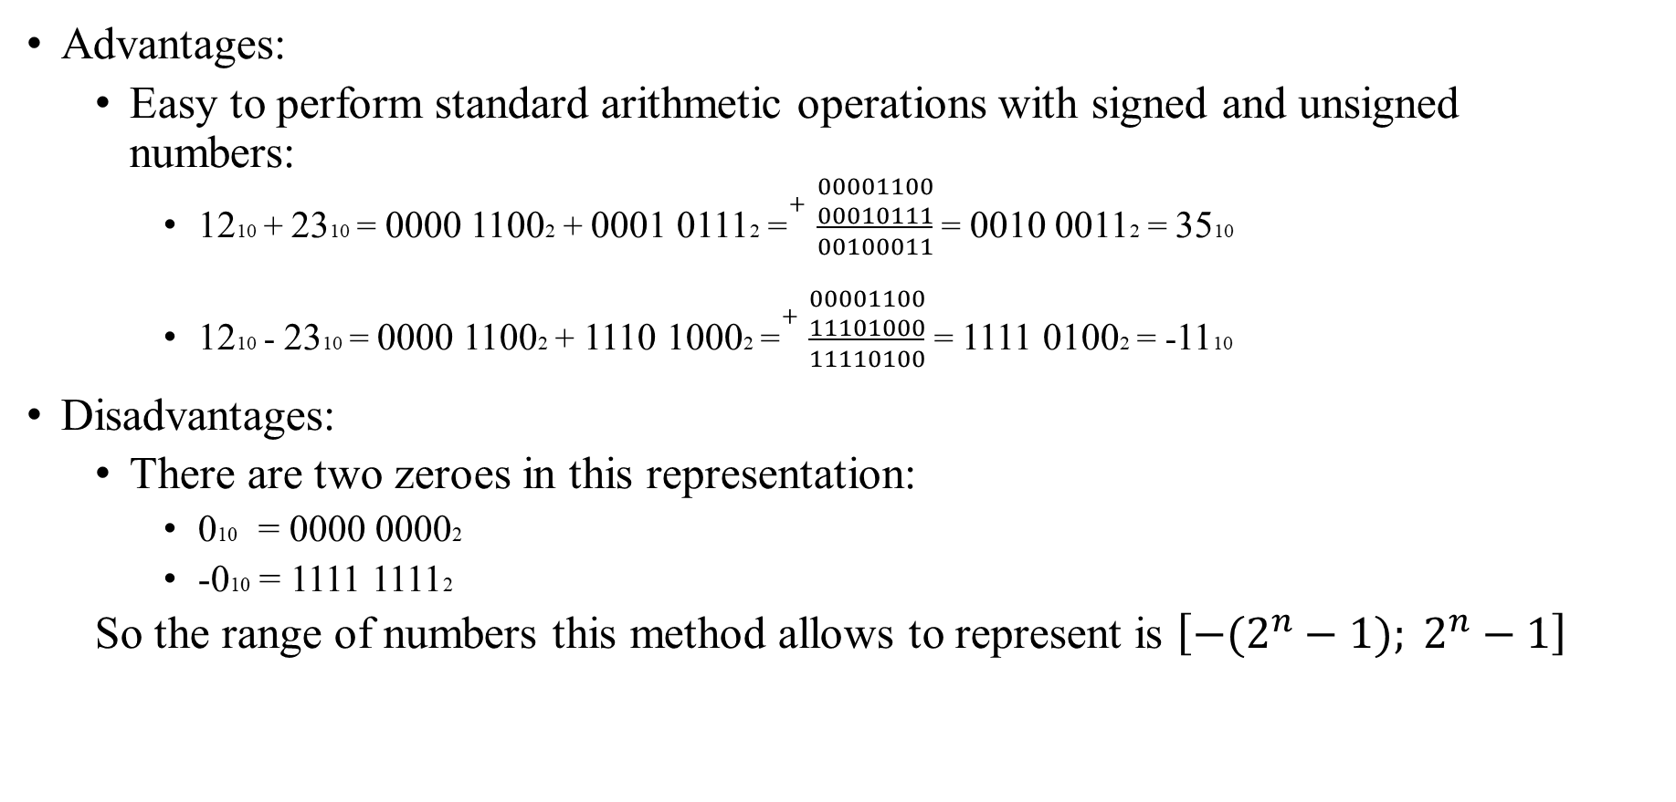
Numbers representation Ones' complement
Advantages:
Easy to perform standard arithmetic operations with signed and unsigned numbers:
1210 + 2310 = 0000 11002 + 0001 01112 =$\begin{matrix}+ \\ \\ \end{matrix}$ $\frac{\begin{matrix}00001100 \\ 00010111\end{matrix}}{00100011}$ = 0010 00112 = 3510
1210 - 2310 = 0000 11002 + 1110 10002 =$\begin{matrix}+ \\ \\ \end{matrix}$ $\frac{\begin{matrix}00001100 \\ 11101000\end{matrix}}{11110100}$ = 1111 01002 = -1110
Disadvantages:
There are two zeroes in this representation:
010 = 0000 00002
-010 = 1111 11112
So the range of numbers this method allows to represent is $\left[−(2^{n}−1)\right.; \left.2^{n}−1\right]$

Slide 8
Numbers representation Two's complement
Positive numbers are the same simple, negative values are the bit complement of the corresponding positive value, the value of 1 is then added to the resulting value, ignoring the overflow which occurs when taking the two's complement of 0:
1310 = 0001 11012
-1310 = 1110 00112
9110 = 0101 10112
-9110 = 1010 01012
010 = -010 = 0000 00002

Slide 9
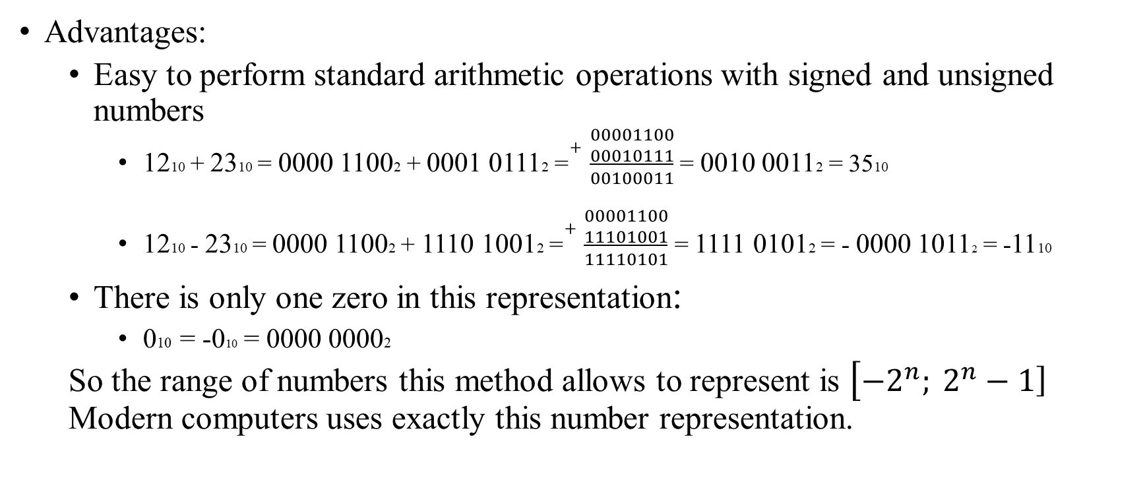
Numbers representation Two's complement
Advantages:
Easy to perform standard arithmetic operations with signed and unsigned numbers
1210 + 2310 = 0000 11002 + 0001 01112 =$\begin{matrix}+ \\ \\ \end{matrix}$ $\frac{\begin{matrix}00001100 \\ 00010111\end{matrix}}{00100011}$ = 0010 00112 = 3510
1210 - 2310 = 0000 11002 + 1110 10012 =$\begin{matrix}+ \\ \\ \end{matrix}$ $\frac{\begin{matrix}00001100 \\ 11101001\end{matrix}}{11110101}$ = 1111 01012 = - 0000 10112 = -1110
There is only one zero in this representation:
010 = -010 = 0000 00002
So the range of numbers this method allows to represent is $\left[−2^{n}\right.; \left.2^{n}−1\right]$ Modern computers uses exactly this number representation.

Slide 10
Bitwise operations
Bitwise operators are a binary operators and treat their operands as a sequence of N bits (zeroes and ones), rather than as decimal numbers. For example, the decimal number 9 has a binary representation of 1001. Bitwise operators perform their operations on such binary representations.
Each bit in the first operand is paired with the corresponding bit in the second operand: first bit to first bit, second bit to second bit, and so on.
The operator is applied to each pair of bits, and the result is constructed bitwise.

Slide 11
Bitwise operations
The following table summarizes all bitwise operators:
Operation name | Operation operator
OR | |
AND | &
XOR | ^
RIGHT SHIFT | >>
LEFT SHIFT | <<
COMPLEMENT, NOT | ~

Slide 12
Bitwise operations & (AND)
Performs the AND operation on each pair of bits.
x AND y yields 1 only if both x and y are 1. The truth table for the AND operation is:
x | y | x AND y
0 | 0 | 0
0 | 1 | 0
1 | 0 | 0
1 | 1 | 1

Slide 13

Bitwise operations & (AND)
Examples:
1210 & 2310 = 0000 11002 & 0001 01112 =$\begin{matrix}\& \\ \\ \end{matrix}$ $\frac{\begin{matrix}00001100 \\ 00010111\end{matrix}}{00000100}$ = 0000 01002 = 410
5110 & 2510 = 0011 00112 & 0001 10012 =$\begin{matrix}\& \\ \\ \end{matrix}$ $\frac{\begin{matrix}00110011 \\ 00011001\end{matrix}}{00010001}$ = 0001 00012 = 1710

Slide 14
Bitwise operations | (OR)
Performs the OR operation on each pair of bits.
x OR y yields 1 only if either x or y are 1. The truth table for the OR operation is
x | y | x OR y
0 | 0 | 0
0 | 1 | 1
1 | 0 | 1
1 | 1 | 1

Slide 15

Bitwise operations | (OR)
Examples:
1210 | 2310 = 0000 11002 | 0001 01112 =$\begin{matrix}| \\ \\ \end{matrix}$ $\frac{\begin{matrix}00001100 \\ 00010111\end{matrix}}{00011111}$ = 0001 11112 = 3110
5110 | 2510 = 0011 00112 | 0001 10012 =$\begin{matrix}| \\ \\ \end{matrix}$ $\frac{\begin{matrix}00110011 \\ 00011001\end{matrix}}{00111011}$ = 0011 10112 = 5910

Slide 16
Bitwise operations ^ (XOR)
Performs the XOR operation on each pair of bits.
x XOR y yields 1 if x and y are different. The truth table for the XOR operation is
x | y | x XOR y
0 | 0 | 0
0 | 1 | 1
1 | 0 | 1
1 | 1 | 0

Slide 17

Bitwise operations ^ (XOR)
Examples:
1210 ^ 2310 = 0000 11002 ^ 0001 01112 =$\begin{matrix}^ \\ \\ \end{matrix}$ $\frac{\begin{matrix}00001100 \\ 00010111\end{matrix}}{00011011}$ = 0001 10112 = 2710
5110 ^ 2510 = 0011 00112 ^ 0001 10012 =$\begin{matrix}^ \\ \\ \end{matrix}$ $\frac{\begin{matrix}00110011 \\ 00011001\end{matrix}}{00101010}$ = 0010 10102 = 4210

Slide 18
Bitwise operations Relations
The relations table for AND, OR and XOR is:
& | | | ^
x&y == y&x | x|y == y|x | x^y == y^x
(x&y)&z == x&(y&z) | (x|y)|z == x|(y|z) | (x^y)^z == x^(y^z)
x & 0 == 0 | x | 0 == x | x ^ 0 == x
x & x = x | x | x = x | x ^ x = 0

Slide 19
Bitwise operations ~ (COMPLEMENT, NOT)
Performs the NOT operation on each bit.
NOT x yields the inverted value (a.k.a. one's complement) of x. The truth table for the NOT operation is:
Examples:
~2310 = ~0001 01112 = 1110 10002
~2510 = ~0001 10012 = 1110 01102
x | ~x
0 | 1
1 | 0

Slide 20
Bitwise operations << (LEFT SHIFT)
This operator shifts the first operand the specified number of bits to the left.
Excess bits shifted off to the left are discarded. Zero bits are shifted in from the right.
Example:
1210 << 210 = 0000 11002 << 210 = 0011 00002 = 4810
2710 << 310 = 0001 10112 << 310 = 1101 10002 = 21610
3710 << 410 = 0010 01012 << 410 = 0101 00002 = 8010

Slide 21
Bitwise operations >> (RIGHT SHIFT)
This operator shifts the first operand the specified number of bits to the right.
Excess bits shifted off to the right are discarded. Zero bits are shifted in from the left.
Example:
1210 >> 210 = 0000 11002 >> 210 = 0000 00112 = 310
2710 >> 310 = 0001 10112 >> 310 = 0000 00112 = 310
3710 >> 410 = 0010 01012 >> 410 = 0000 00102 = 210

Slide 22
Bitwise operations Manipulations
i-th power of 2:
1 << i
Change i-th bit of number n to 1:
n = n | (1 << i);
Change i-th bit of number n to 0:
n = n & ~(1 << i);
Toggle i-th bit of number n:
n = n ^ (1 << i);
Check if i-th bit is 1:
if(n & (1 << i) != 0)

Slide 23
Bitwise operations Problem: Single number
You are given an array of integers. Every element appears twice, except for one. You need to find the element that appears only one time. Your solution should have a linear runtime complexity (O(n)). Try to implement it without using extra memory.
Examples:
Input | Output
5 3 5 2 2 3 | 5
7 2 3 4 1 1 3 4 | 2

Slide 24

Bitwise operations Problem: Single number
Solution is following: You just need to XOR all the numbers with each other. Result will be the answer.
Examples:
$3 ^ 5 ^ 2 ^ 2 ^ 3 = 2 ^ 2 ^ 3 ^ 3 ^ 5 = 0 ^ 0 ^ 5 = 5$
$2 ^ 3 ^ 4 ^ 1 ^ 1 ^ 3 ^ 4 = 1 ^ 1 ^ 2 ^ 3 ^ 3 ^ 4 ^ 4 = 0 ^ 2 ^ 0 ^ 0 = 2$
Input | Output
5 3 5 2 2 3 | 5
7 2 3 4 1 1 3 4 | 2

Slide 25
Bitwise operations Problem: Subsets
Generate all subsets of the given set
Examples:
Input | Output
3 1 2 5 | {} {1} {2} {5} {1, 2} {2, 5} {1, 5} {1, 2, 5}

Slide 26
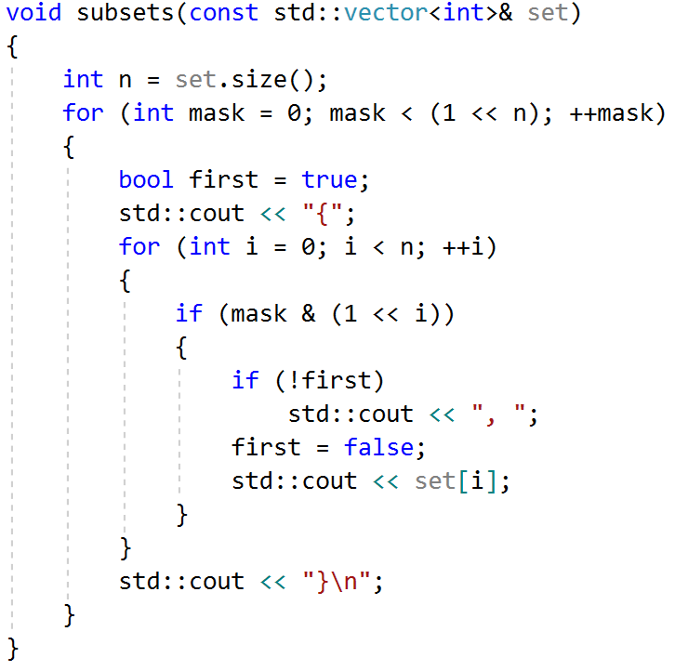
Bitwise operations Problem: Subsets
Solution:

Slide 27
Bitwise operations Problem: K-Subsets
Generate all subsets of length K of the given set
Examples:
Input | Output
5 2 1 2 3 4 5 | 1 2 1 3 1 4 1 5 2 3 2 4 2 5 3 4 3 5 4 5

Slide 28
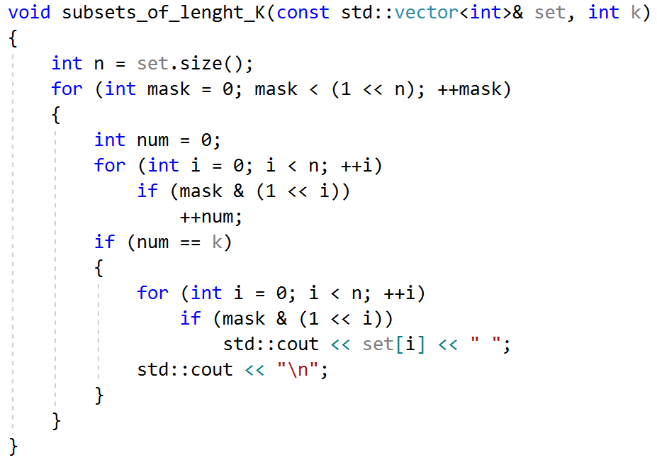
Bitwise operations Problem: K-Subsets
Solution:

